Slide 1
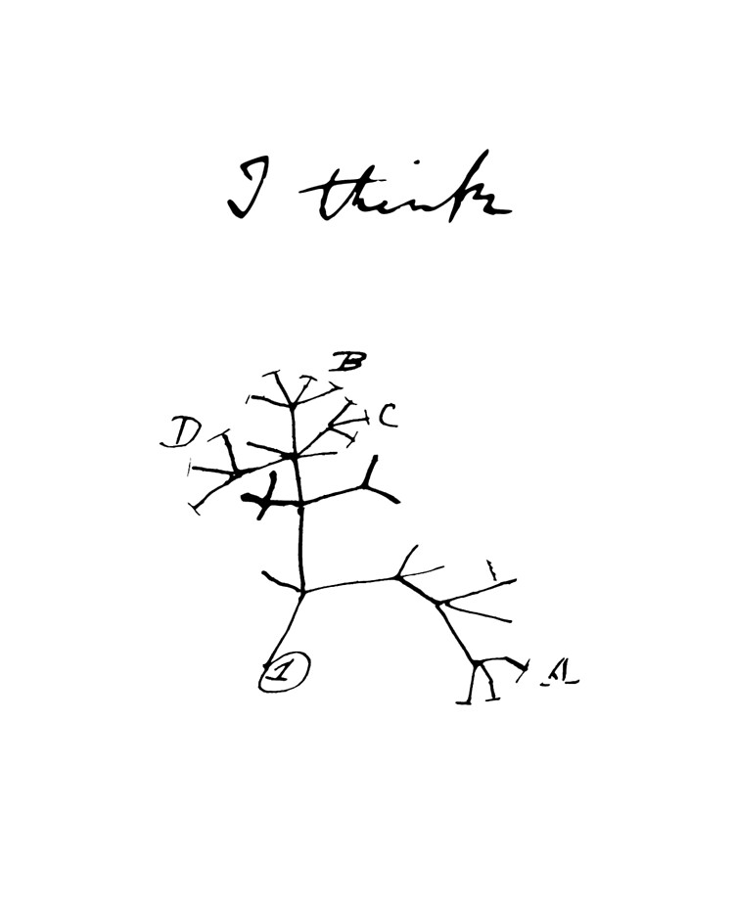
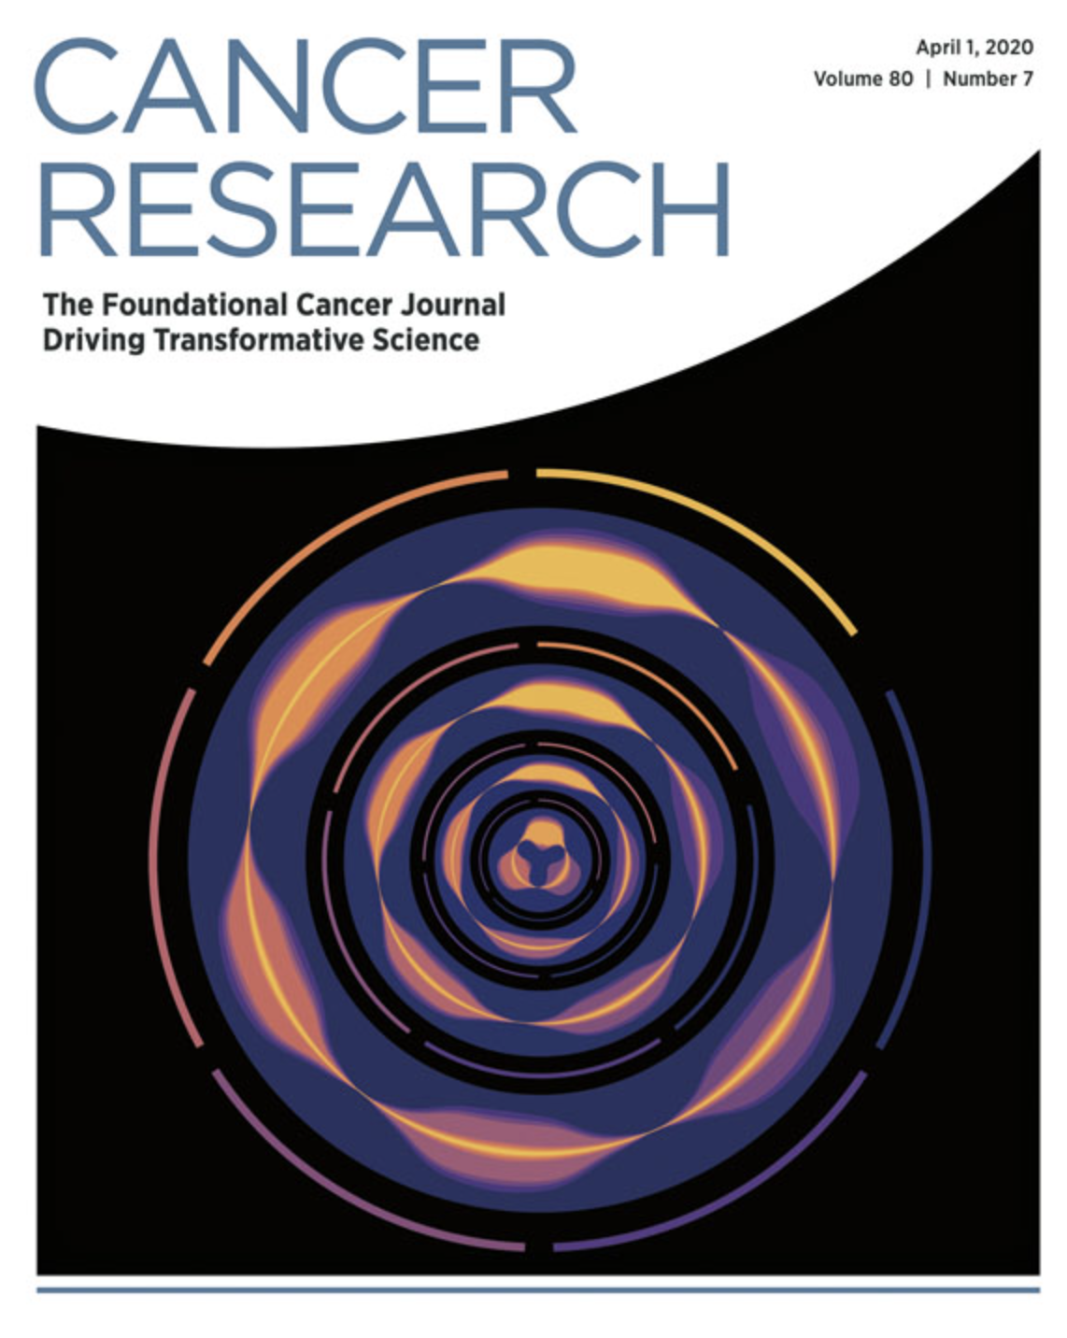
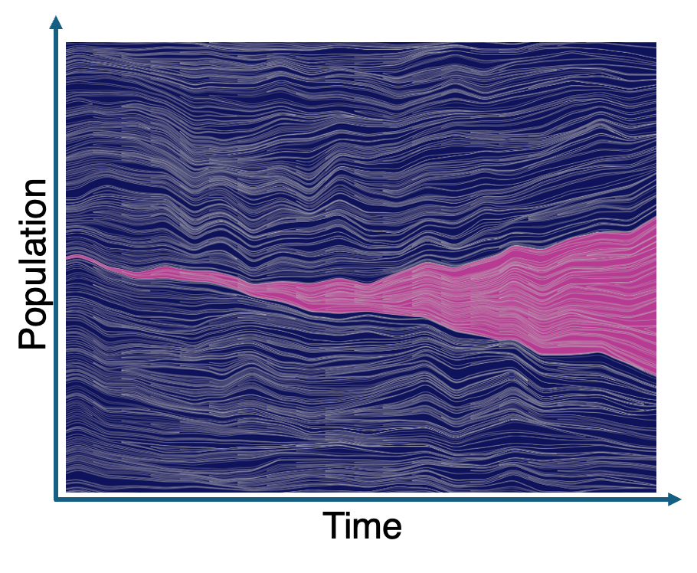
IMAT lecture series
Lineage Tracing in HAL
Chandler Gatenbee
Sadegh Marzban
Jan 2025

Slide 2
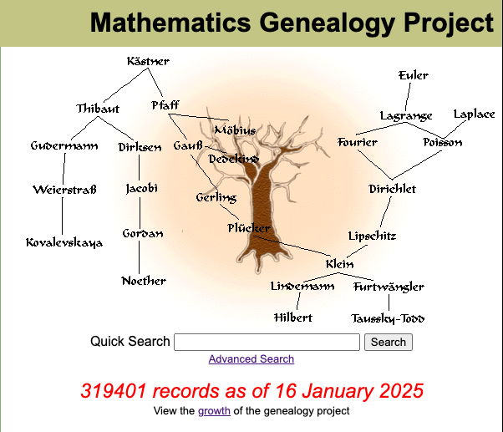
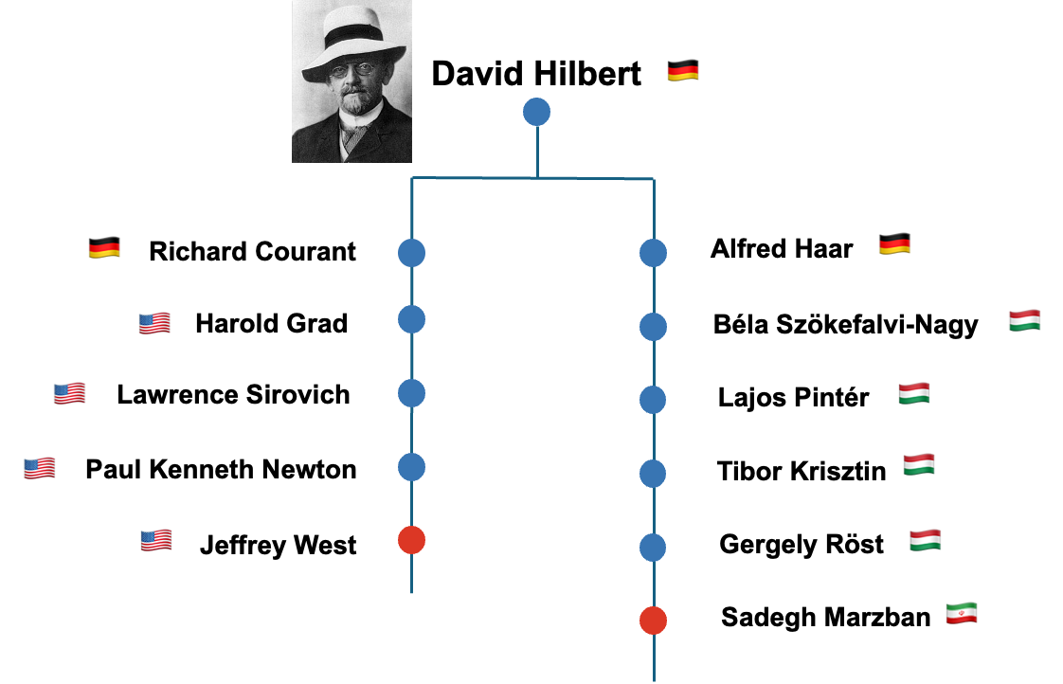
The net outcome of high beneficial mutation rates is that, even at relatively small population sizes (> 106 cells), many beneficial mutations enter the population contemporaneously and compete with one another [1], [2], [3], [31], [32], [33]. This process, known as clonal interference, blunts the impact of any one mutation on the population, and, more practically, makes evolution difficult to study
What’s a meaning of clone?
Why lineage tracing?
Solution by Rev. H. W. Watson: Watson introduced branching processes, a method analyzing stochastic offspring patterns.
Lineage fate = Chance effects + Deterministic growth/decline.
Lineage tracking can detect a beneficial mutation at an extremely low frequency within the population, and estimate its time of occurrence and fitness effect. This could be particularly relevant to the evolution of drug resistance where there is growing evidence that, in some cases, it could be driven by a large number of low-abundance (and weak fitness-effect) mutations.
A Brief History of Lineage Tracing
Origins in Victorian England: Lineage tracing emerged to address why aristocratic family names were going extinct. Aristocrats were having fewer children, raising concerns that the “proletariat” might take over.
Francis Galton's Insight (1873): Galton recognized that extinction was driven by both systematic differences in growth rates and chance.
He posed a mathematical challenge:
What proportion of surnames will go extinct after several generations?
How many individuals will share the same surname over time?

Slide 3
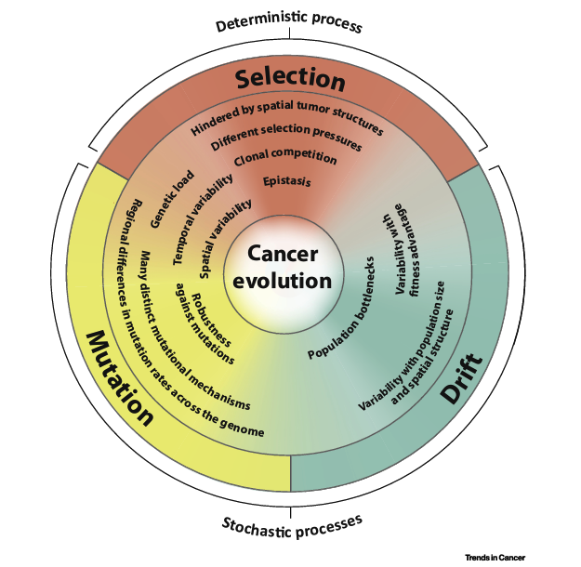
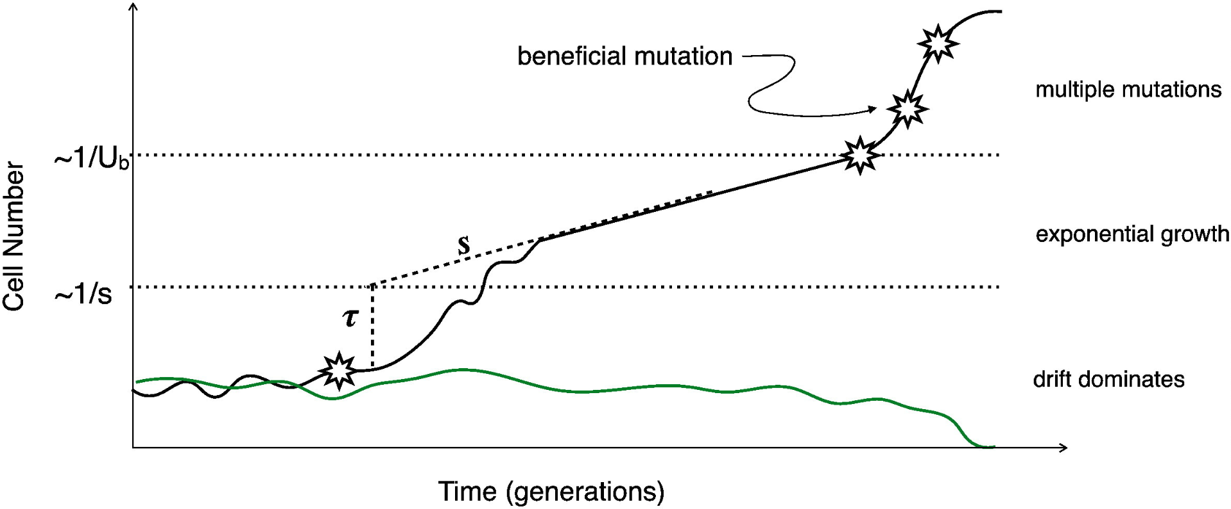
Lineage Tracing: Understanding Cellular Evolution
Why is Lineage Tracing Useful?
Cancer Research:
Tracks tumor growth, metastasis, and drug resistance dynamics.
Distinguishes between "driver" and "passenger" mutations in cancer evolution.
Identifies low-frequency mutations often missed by genome sequencing.
lineage begins to grow exponentially, at a rate proportional to its fitness advantage (rate = s)
Lipinski, Kamil A., et al. "Cancer evolution and the limits of predictability in precision cancer medicine." Trends in cancer 2.1 (2016).
Sometimes, a lineage acquires a beneficial mutation (marked by a star), which provides it with a fitness advantage (selection coefficient, s)
A small lineage that does not acquire a beneficial mutation (neutral, green) will fluctuate in cell number due to drift
Blundell JR, Levy SF. Beyond genome sequencing: lineage tracking with barcodes to study the dynamics of evolution, infection, and cancer. Genomics. 2014
the beneficial mutation allows the lineage to outcompete other lineages in the population.

Slide 4
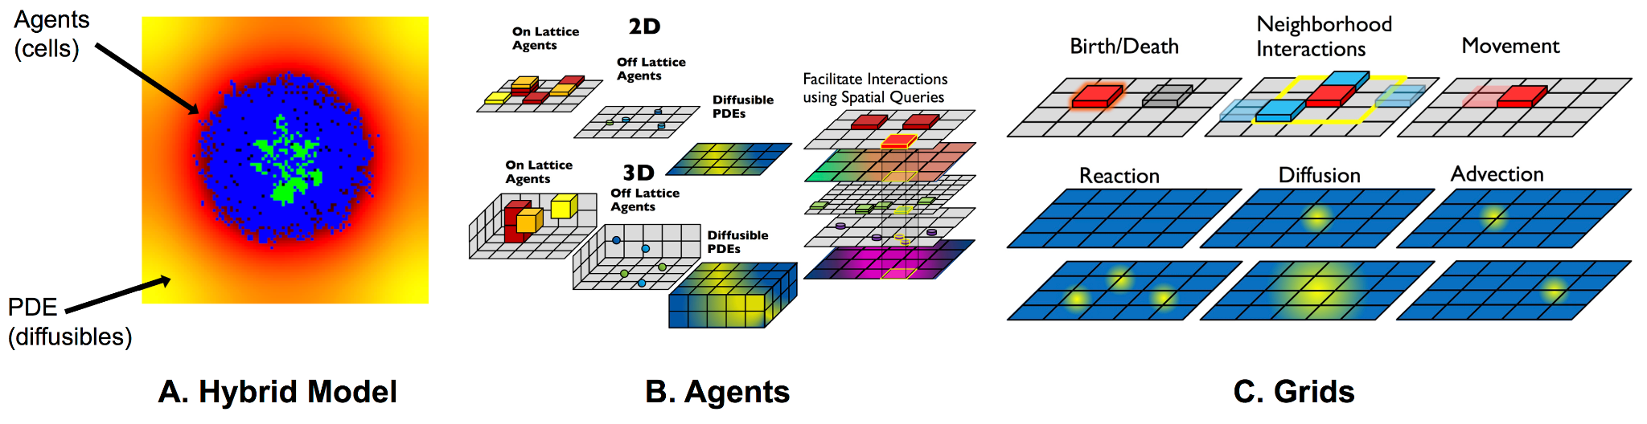
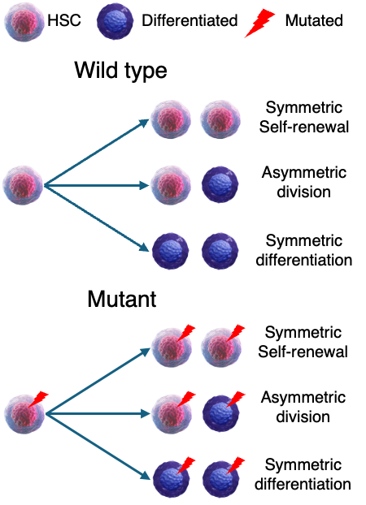
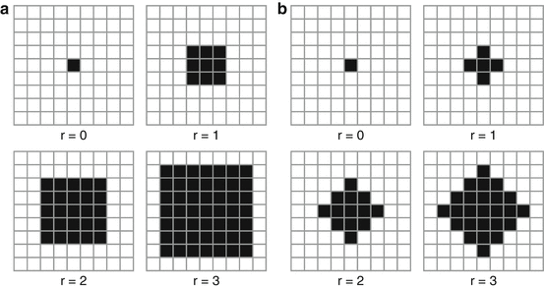
HAL
Hybrid - discrete AMBs
https://halloworld.org/
Neighborhoods
Birth
Death
Mutant

Slide 5
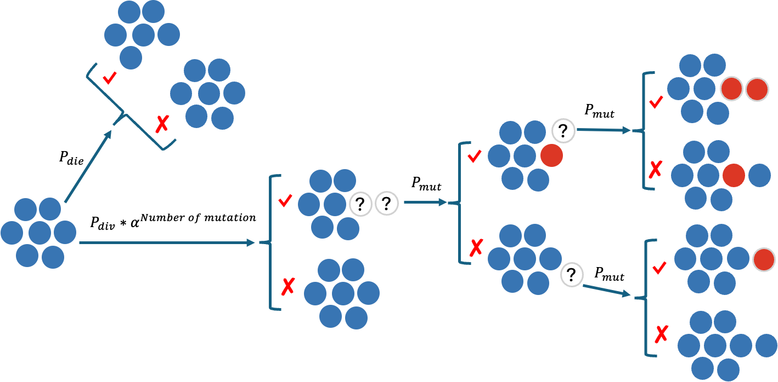

Birth- death- mutation process

Slide 6
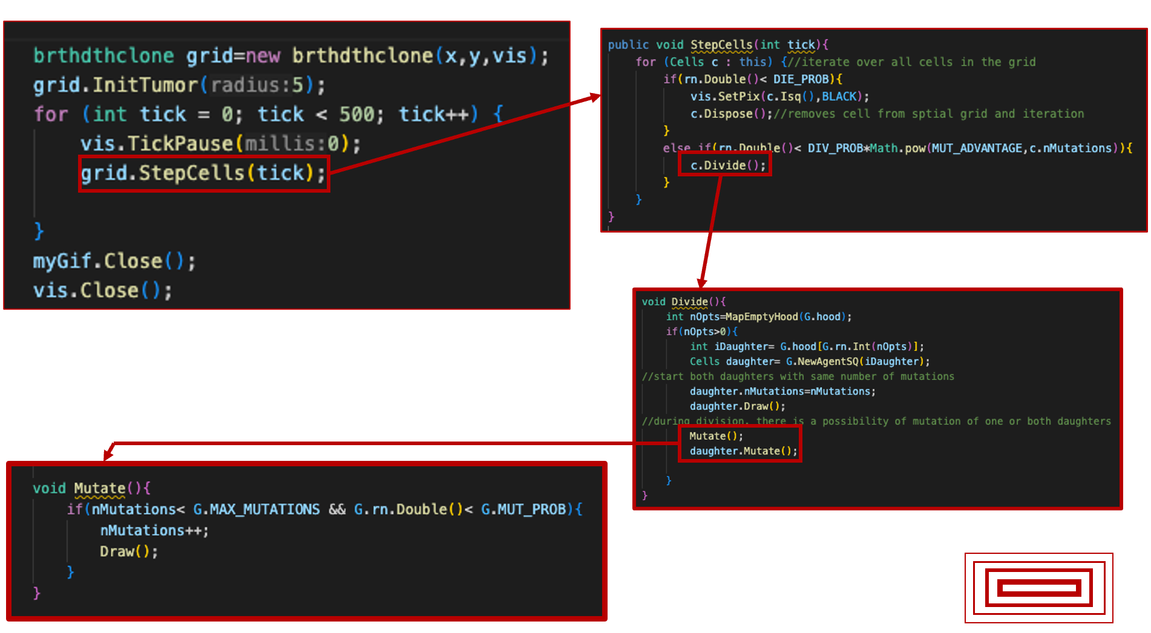
Birth- death- mutation process

Slide 7
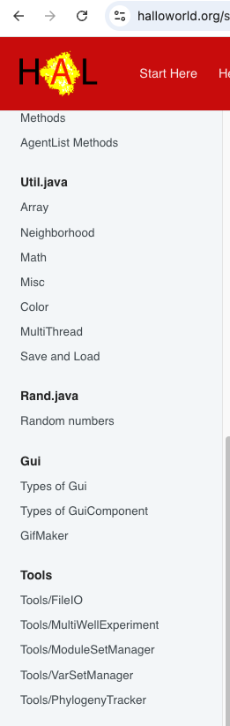
Phylogeny Tracker in HAL
Genome is the HAL class that record the lineage from PhylogenyTracker package in HAL.
The genome class is useful for keeping track of shared genetic information and phylogenies.
•GetId(): gets the ID of the genome, which indicates the order in which it arose
•GetPop(): returns the current active population that shares this genome
•GetParent(): returns the parent genome that was mutated to give rise to this genome
•SetPop(pop): sets the active population size for this genome to a specific value.
•IncPop(): adds an individual to the genome population, should be called as part of the initialization of all agents that share this genome.
•DecPop(): removes an individual from the genome population, should be called as part of the disposal of all agents that share this genome.

Slide 8
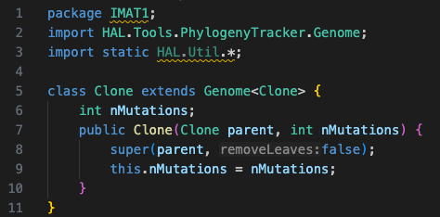
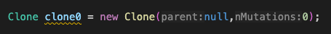
How to use Phylogeny Tracker in HAL
First make a Clone class to record the lineage from Genome class in HAL and have one attribute for our clone as a number of mutation.
We force all the cells to have the common ancestor. So, let’s create a common ancestor clone in a grid class.
Now we have our clone0 with one attribute. We should create the CSV file from our model
So far we have one attribute and we have to get a name to the attributes as of each column in the AttributesList at the end of simulation.

Slide 9
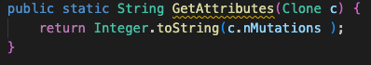
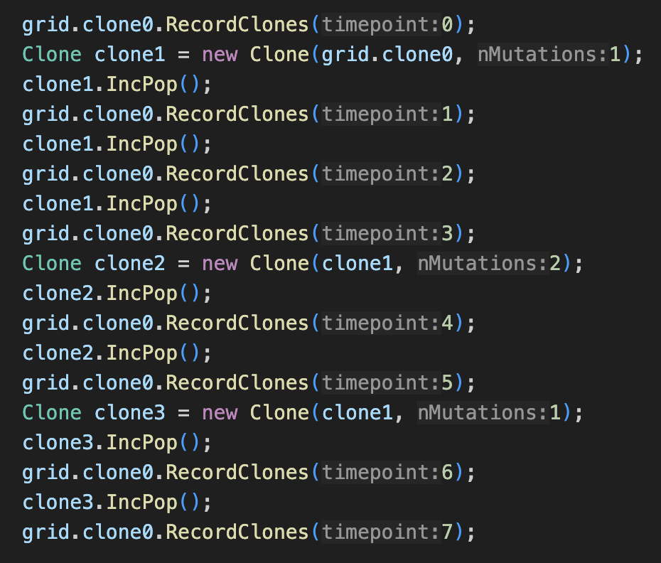
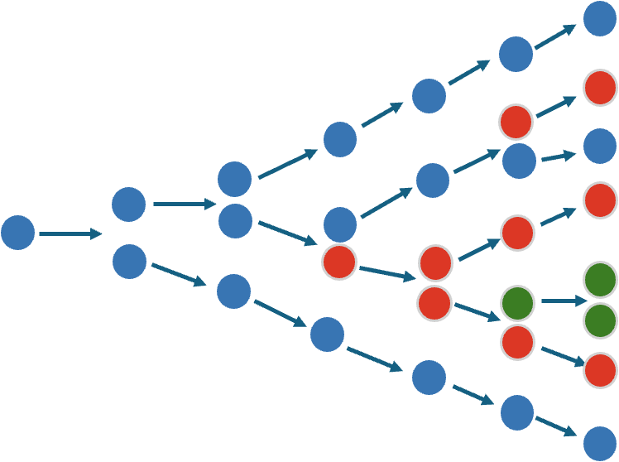
One example of creating Clone and do the mutation
So far we have a single clone, but haven’t recorded any information about it.

Slide 10
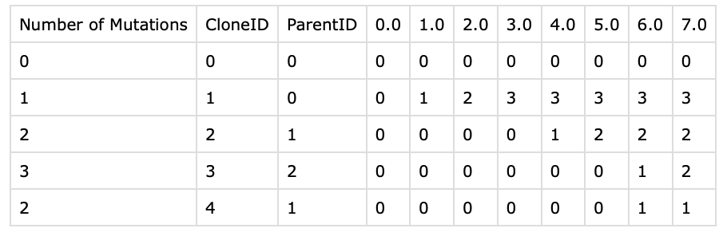
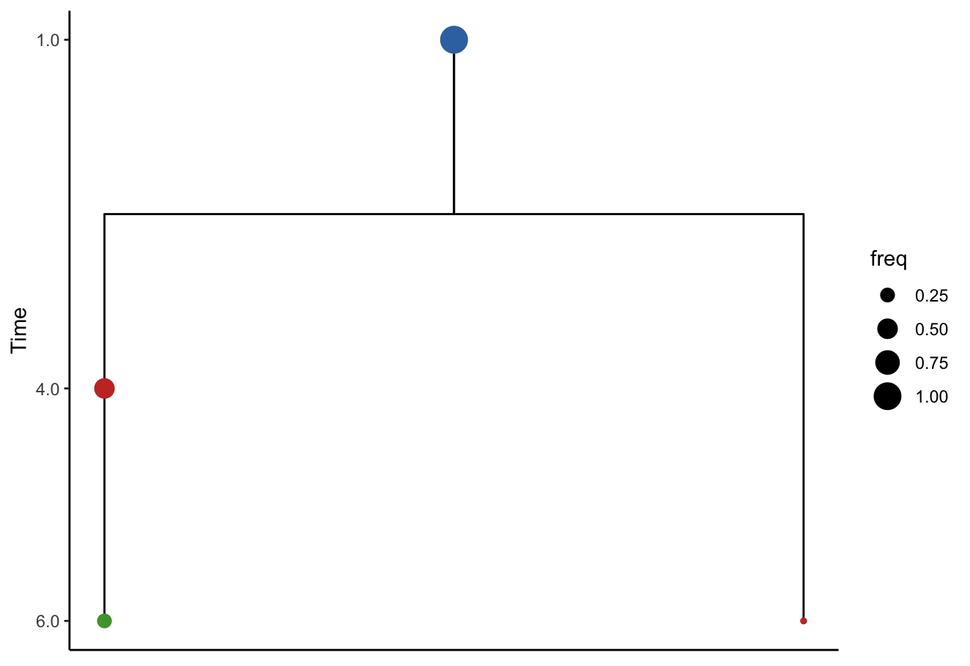
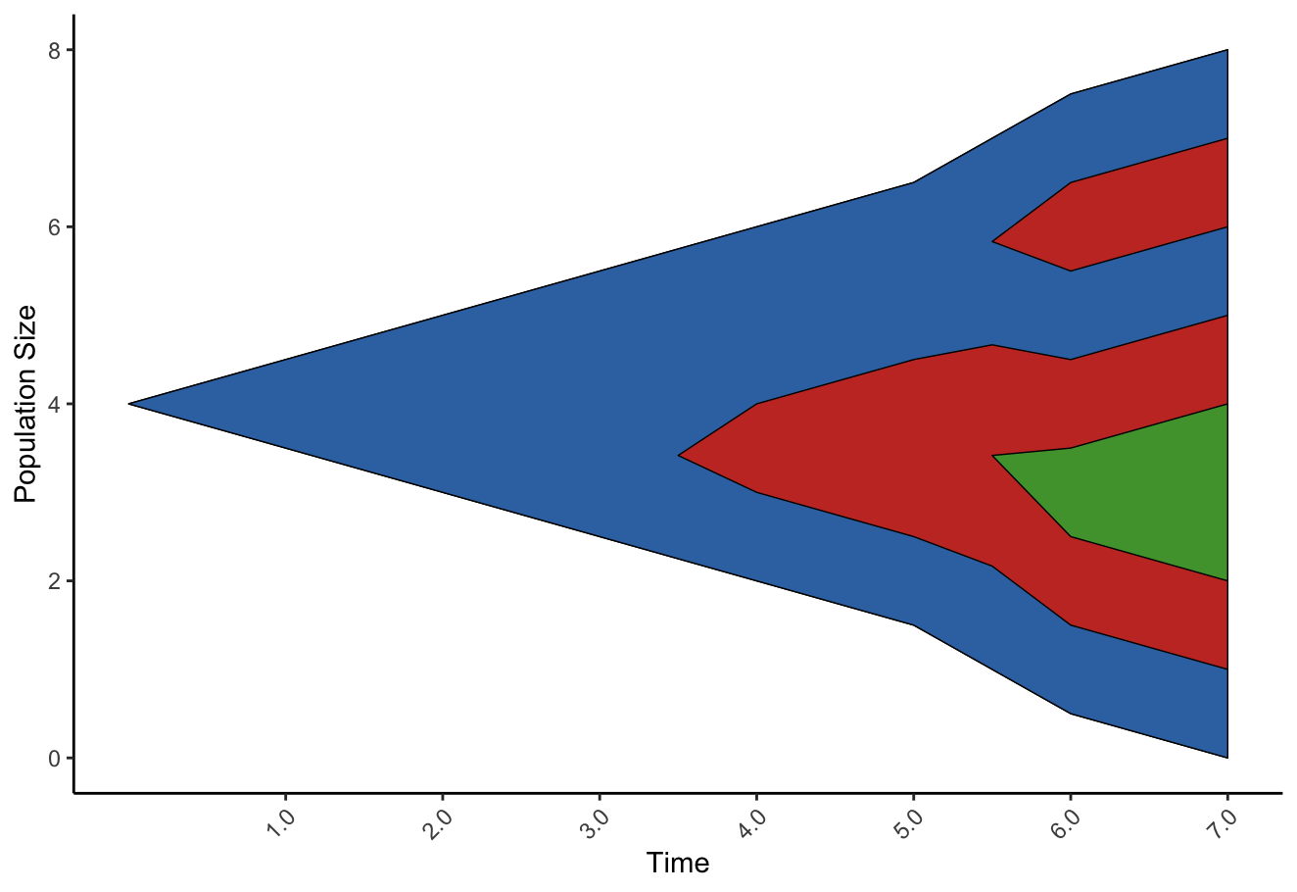
The output CSV file
grid.clone0.OutputClonesToCSV(foldername + "test.csv", AttributesList,(Clone c) -> {return GetAttributes(c); }, 0);

Slide 11
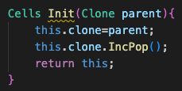
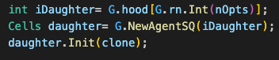
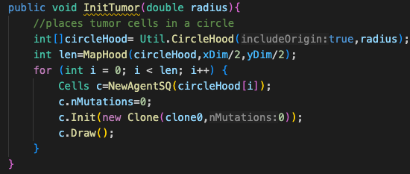
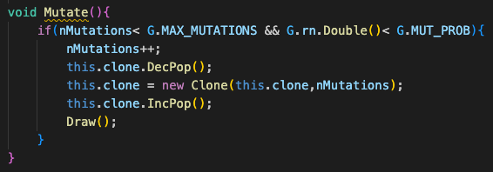
How to monitor a cell's clone in HAL
Each cell has their attribute & every clone has a bunch of cells. So Link the current Cells object to a parent Clone object.
And in the division the daughter cell should initialize with the parent clone and the population of the clone should increase
When the mutation occurs, we should decrease the current clone population and create a new clone population and increase this clone
All the cells are initialize with clone0

Slide 12
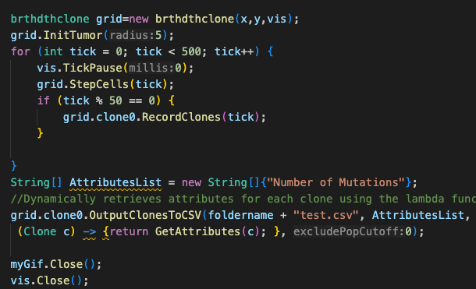
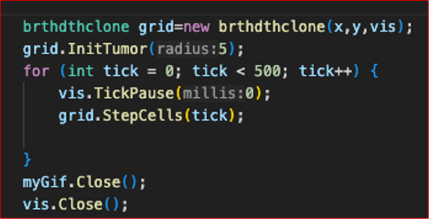
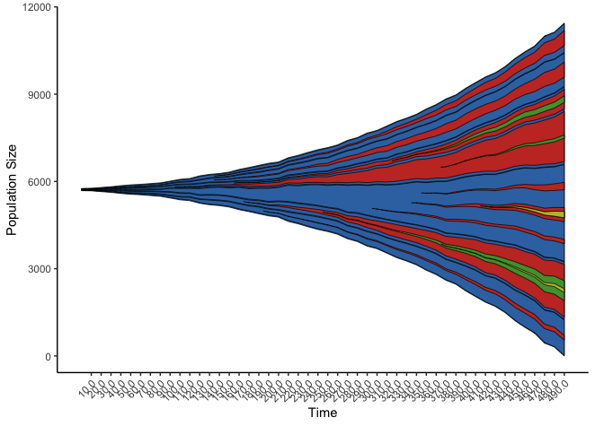
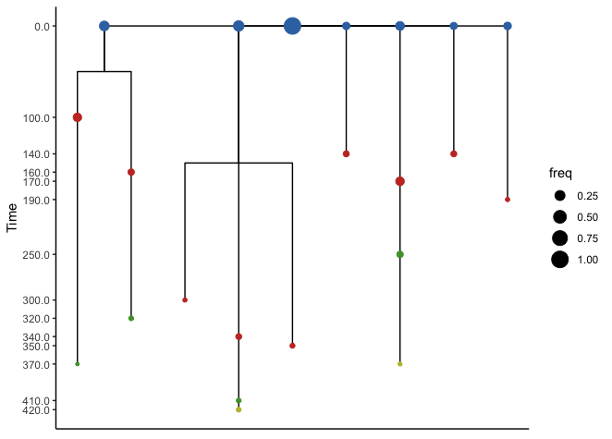

Slide 13
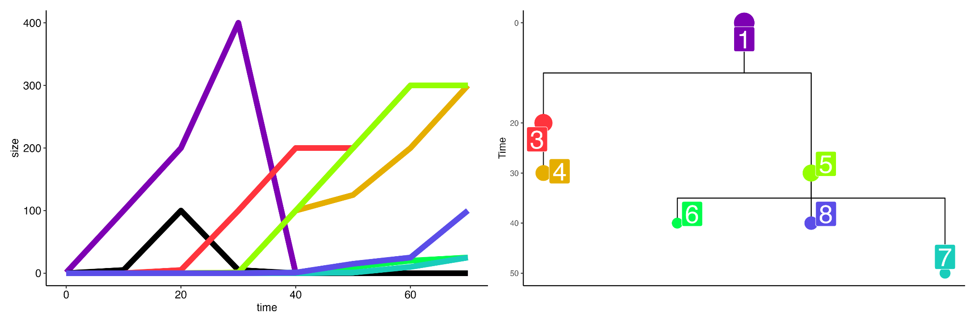
Why Muller plots?
Temporal dynamics
Phylogenetic relationships
2
Can visualize changes in population size with line plots
Phylogenetic trees show evolutionary relationships
Based on single time point (here 70)
Unable to convey temporal dynamics
Can infer extinct populations (1, 2), but only if they have descendants (population 1, but not 2)
dendro_info <- get_evogram(sizes_df, clones, parents)
dendro_plt <- plot_evogram(dendro_pos_df=dendro_info$dendro_pos, link_df = dendro_info$links, orientation="td")
dendro_plt <- dendro_plt +
scale_size_continuous(range=c(5,10)) + # Make points larger
theme(legend.position = "none") # Remove legend
ggsave("tree.png", dendro_plt, width=5, height=5)

Slide 14
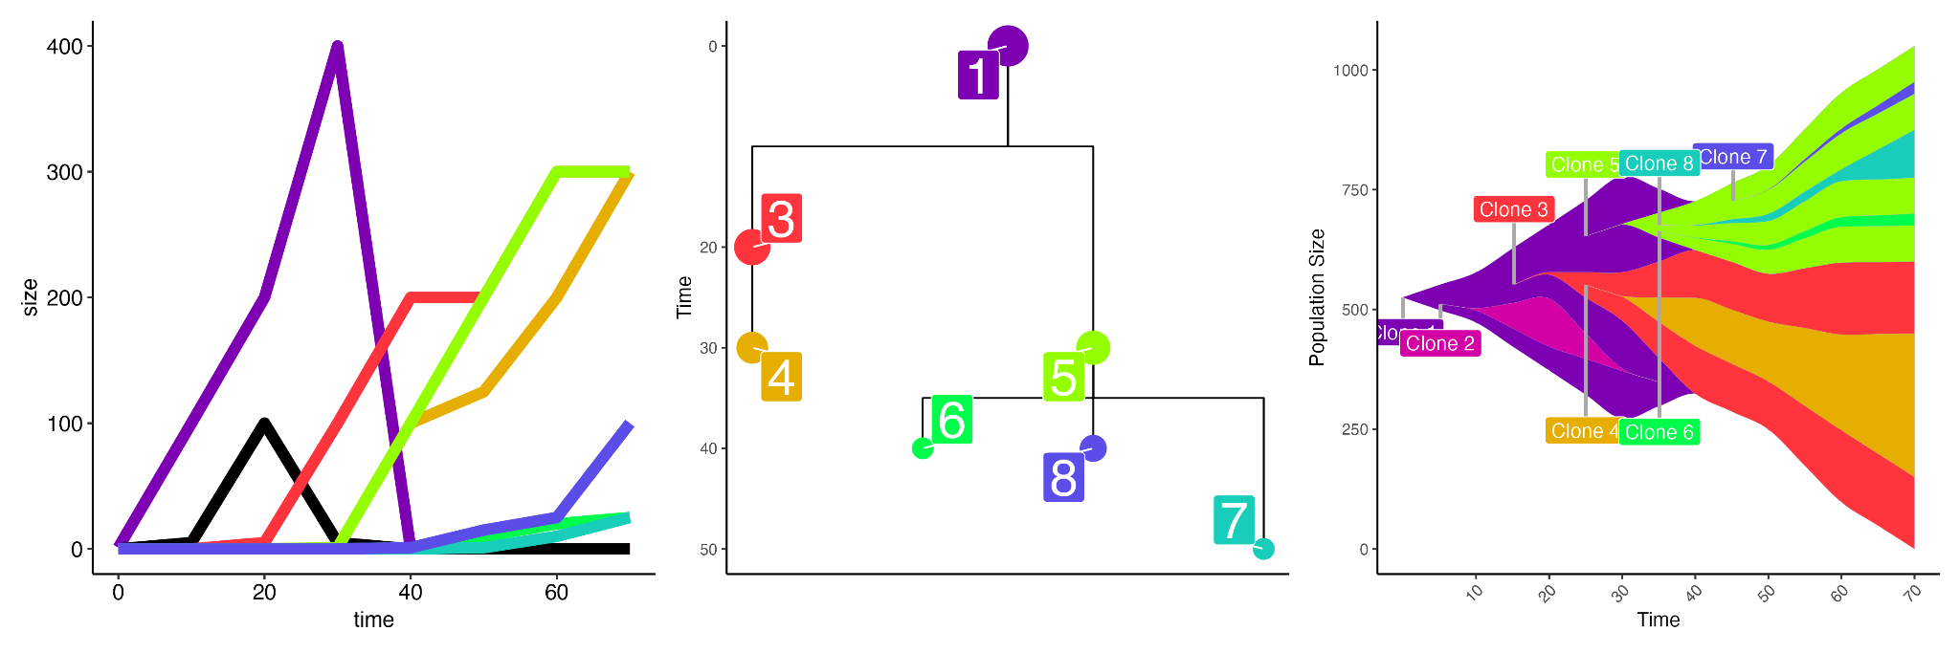
Why Muller plots?
Temporal dynamics
Phylogenetic relationships
Evolutionary dynamics
+
=
Muller plots visualize both changes in population size and phylogenetic relationships!
Can see all populations, even if they went extinct and left no descendants (e.g. population 2)
freq_frame <- get_evofreq(sizes_df, clones, parents) # Get freq_frame, a properly structured data.frame
evo_freq_p <- plot_evofreq(freq_frame) # Get an EvoFreq plot
evo_freq_labeled_p <- get_evofreq_labels(freq_frame, clone_list=clones, extant_only=F, evofreq_plot = evo_freq_p, apply_labels=T) ## Add clone labels
all_p <- size_plot + labeled_dendro + evo_freq_labeled_p

Slide 15
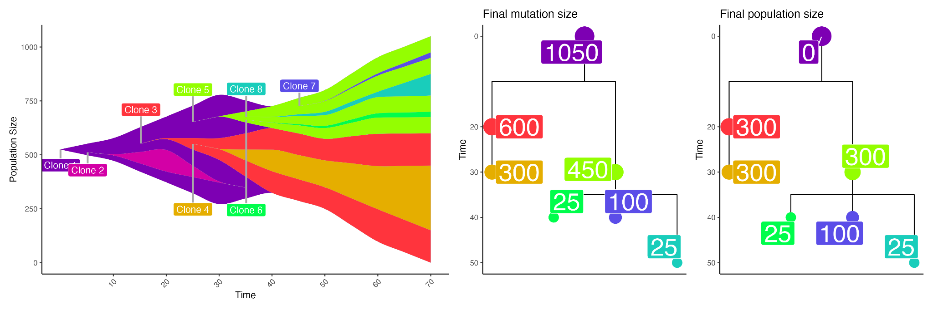
Muller plots
+
Each polygon represents a mutation
Thickness represents the number of individuals that carry the mutation, not the size of the population
The number of cells that carry the Clone 3 mutation is the combined population sizes of Clone 3 + Clone 4
By the end, Clone 1 has gone extinct (right tree), but all descendants carry the mutation (left tree)
Embedded polygons indicate phylogenetic relationship
Clone 4 is a descendant of Clone 3, which is a descendant of Clone 1

Slide 16

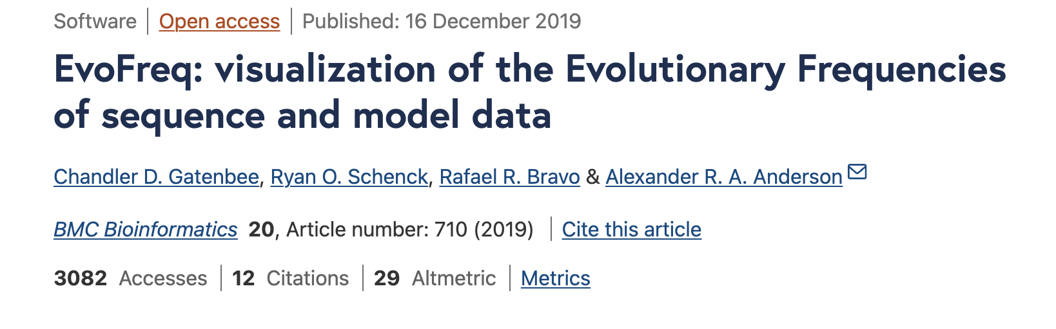
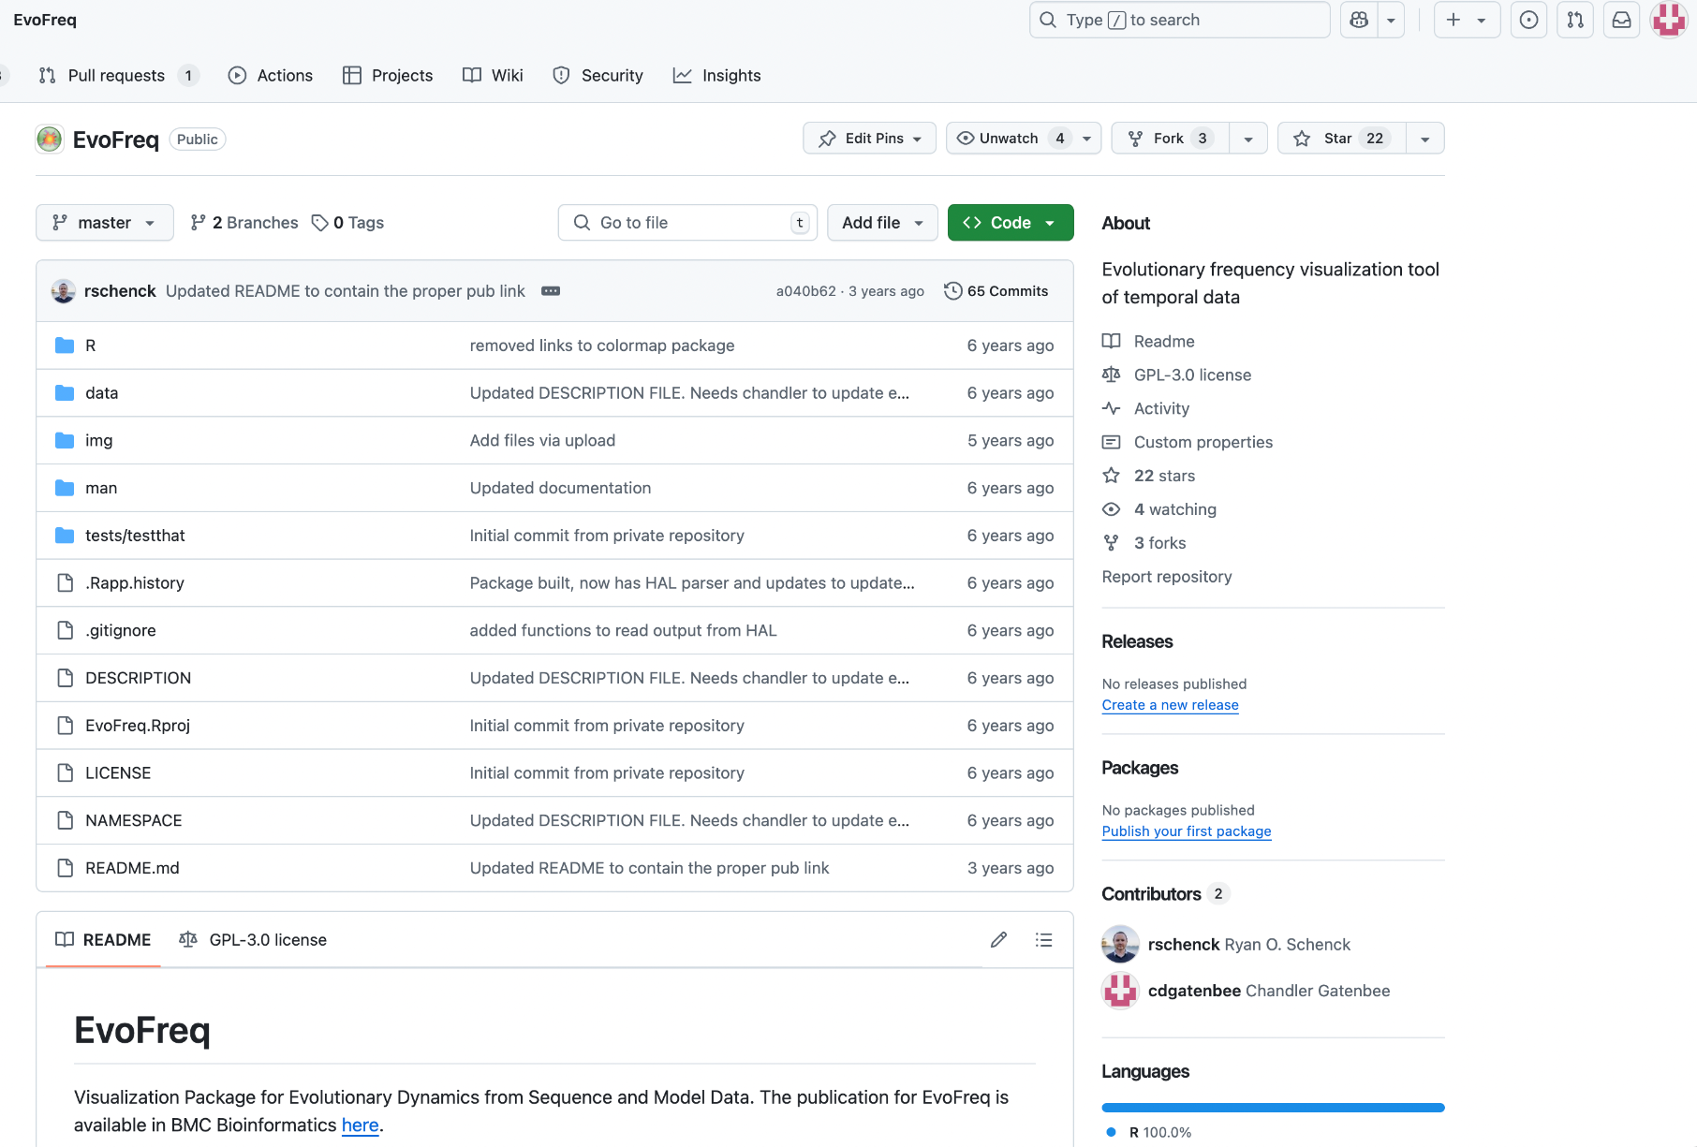
EvoFreq
Worked with Dr. Ryan Schenck on EvoFreq, which is an R package to create Muller plots
There are similar R packages (Fishplot, ggMuller, MullerPlot, etc…), but they had some limitations
Only for simulated data
Only for genomic data
Not compatible with ggplot
Not visually appealing (subjective)
EvoFreq is designed to create smooth Muller plots that can be modified/customized with ggplot
Include functions to read genomic data and simulated data
EvoFreq is available on GitHub
Source code
Installation instructions
Examples
Published in BMC Bioinformatics in 2019

Slide 17
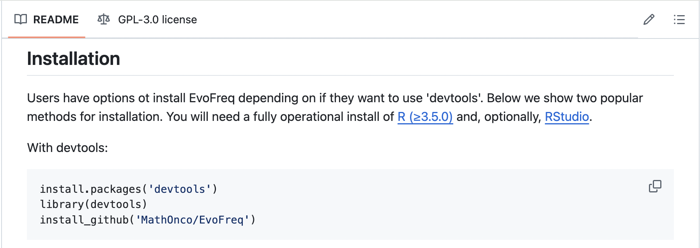
EvoFreq installation
Easily installed with the `devtools` package

Slide 18
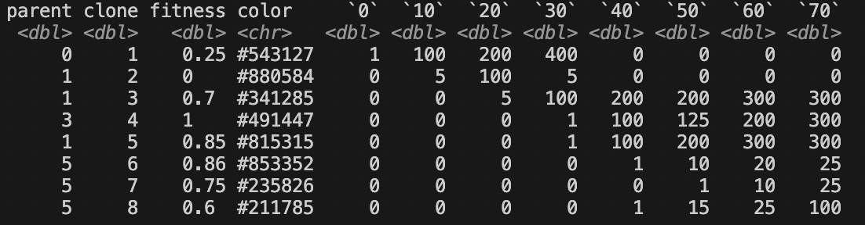
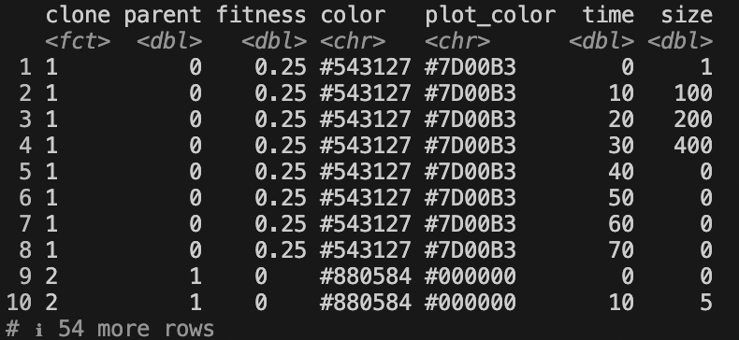
EvoFreq use
Wide format
Long format
Three required pieces of information for each population/clone
Unique ID
ID of parent
Size at each timepoint
Can be provided in 2 formats
Wide: 1 row per clone
Long: 1 row per time point per clone
If data is in long format, the long_to_wide_freq_ready() function can be used to convert it to wide format

Slide 19
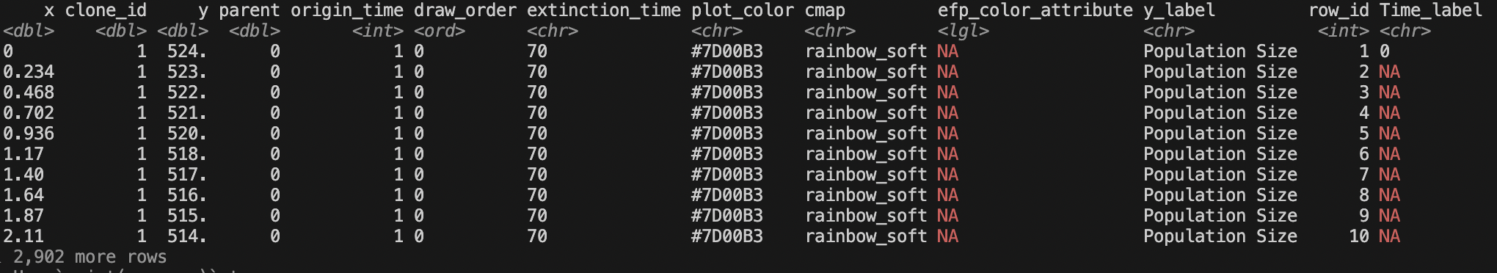
EvoFreq use
Once in wide format, just pass in the population IDs, parent IDs, and population sizes into get_evofreq() to get a freq_frame
The freq_frame contains all of the information used to draw the polygons in the Muller plot
# Get numeric columns, which are usually time points
time_cols <- suppressWarnings(colnames(clone_df)[!is.na(as.numeric(colnames(clone_df)))])
# Use time columns to get population sizes
sizes_df <- clone_df[time_cols]
# Get IDs
clones <- clone_df$clone
# Get parental IDs
parents <- clone_df$parent
# Get freq_frame, a properly structured data.frame
freq_frame <- get_evofreq(sizes_df, clones, parents)

Slide 20
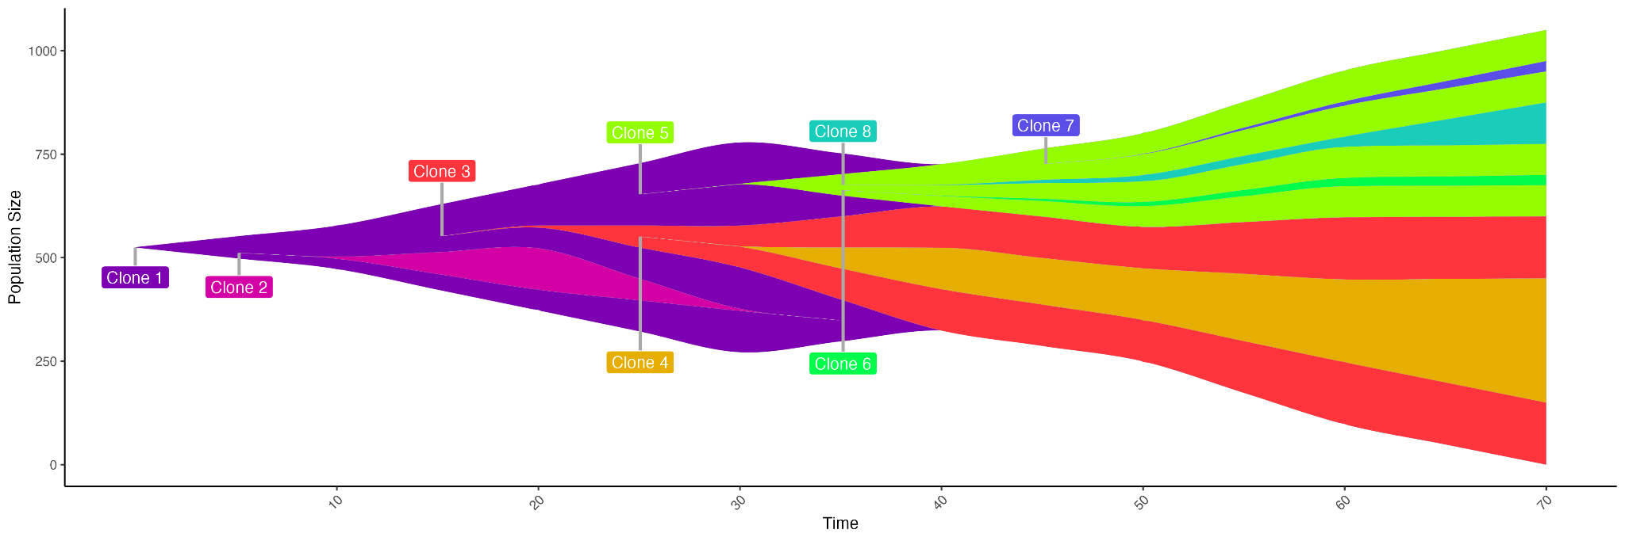
EvoFreq use
evo_freq_p <- plot_evofreq(freq_frame) # Get an EvoFreq plot using freq_frame
evo_freq_labeled_p <- get_evofreq_labels(freq_frame, clone_list=clones, evofreq_plot = evo_freq_p, apply_labels=T) # Add labels
Next, pass the freq_frame to plot_evofreq() to generate the Muller plot
The plot is a ggplot object, and so is easy to modify
get_evofreq_labels() is a convenience function that adds a geom_label to the plot

Slide 21
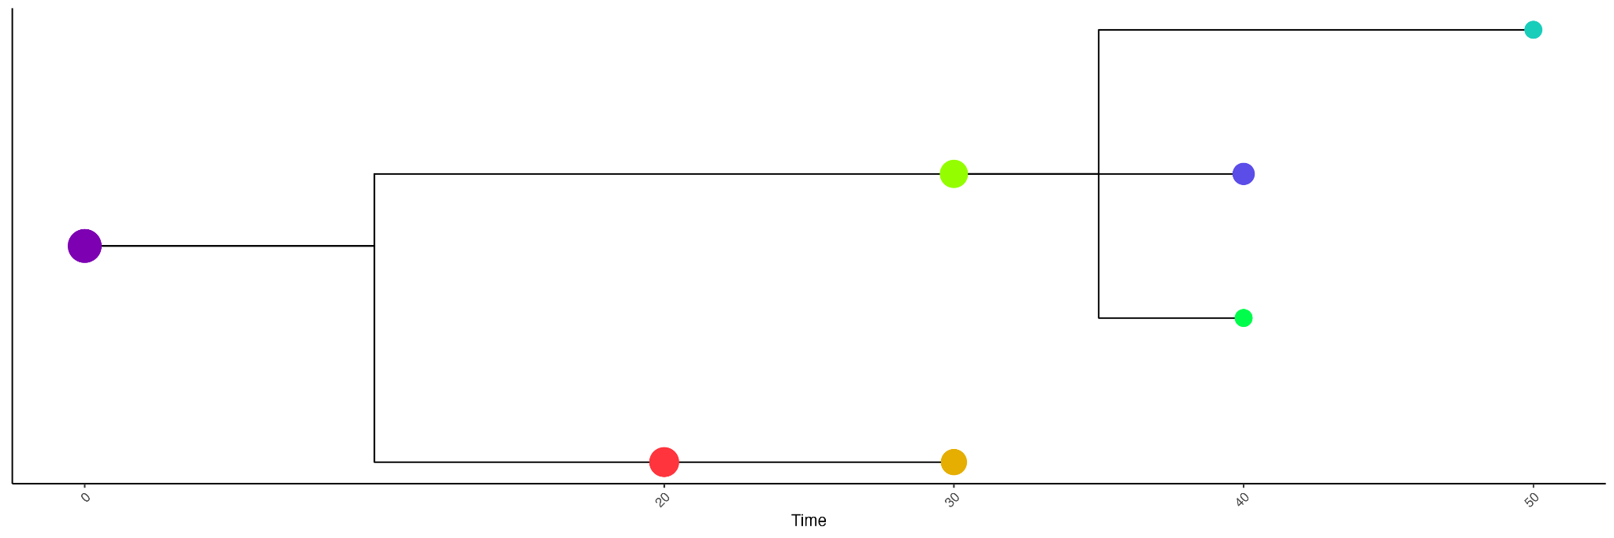
EvoFreq use
# Get evogram, a properly structured data.frame to create dendrogram
dendro_info <- get_evogram(sizes_df, clones, parents)
# Plot dendrogram
dendro_plt <- plot_evogram(dendro_pos_df=dendro_info$dendro_pos, link_df = dendro_info$links, orientation="lr")
In a similar way, can also generate phylogenetic trees using get_evogram() and plot_evogram()

Slide 22
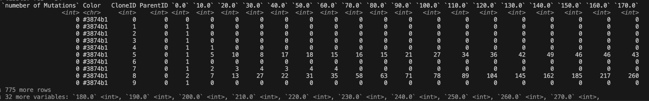
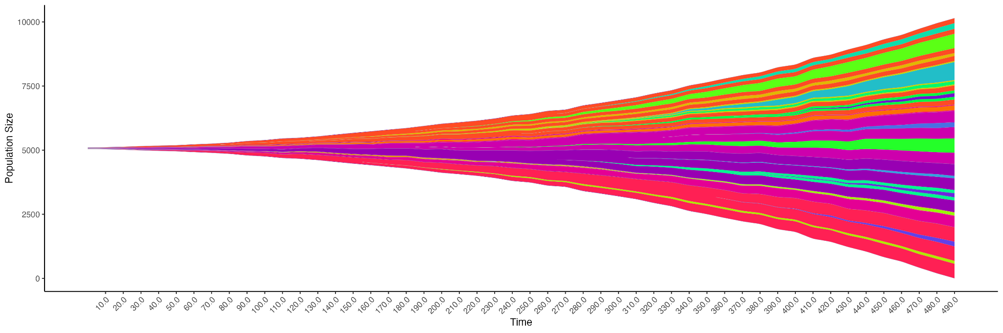
EvoFreq + HAL
HAL can export clonal frequency data using OutputClonesToCSV(), which records the data in wide format:
In EvoFreq, use read.HAL() to automatically read the data, create the freq_frame, and generate the plot
# Read in HAL data
hal_info <- read.HAL(hal_f)
# Show plot
hal_info$evofreq_plot

Slide 23
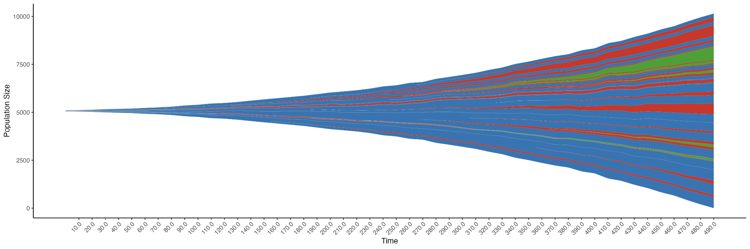
EvoFreq + HAL
To plot using the same colors as used in the ABM, you can set the fill_name argument when calling read.HAL():
# Read in HAL clonal data
hal_info <- read.HAL(hal_f, fill_name = "Color")
# Show plot
hal_info$evofreq_plot

Slide 24
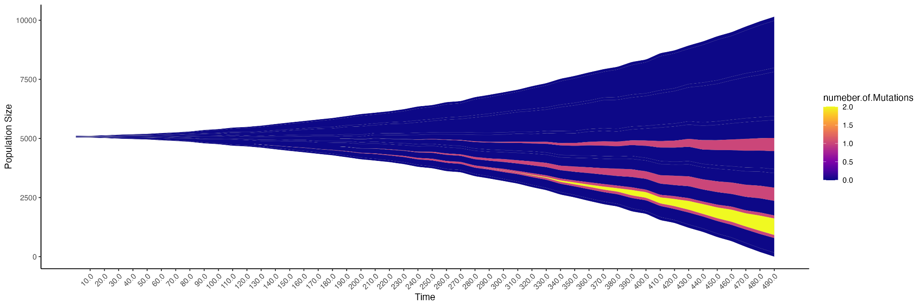
EvoFreq + HAL
read.HAL() also splits the data into individual pieces, making it possible to plot with different arguments
Here, we’ll replot, coloring by number of mutations (fill_value), but using the “plasma” colormap (cmap), and only showing mutations with a frequency > 0.05 (threshold):
# Recreate freq_frame, coloring by different attribute and thresholding to mutations with frequency > 0.05
hal_freq_frame <- get_evofreq(hal_info$size_df, hal_info$clones, hal_info$parents,
fill_value = hal_info$attributes$numeber.of.Mutations, clone_cmap = "plasma",
threshold = 0.05)
# Regenerate plot
hal_evo_freq_p <- plot_evofreq(hal_freq_frame)

Slide 25
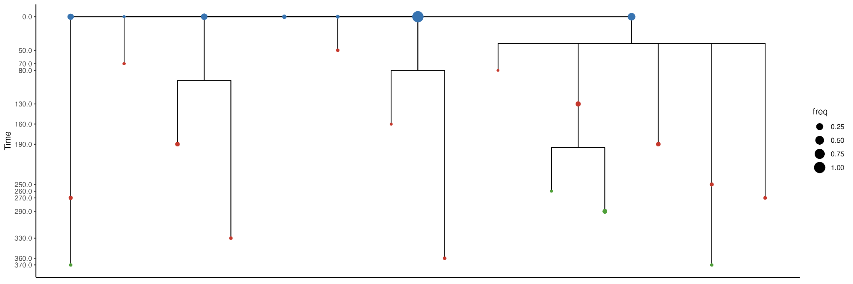
EvoFreq + HAL
Setting et the get_dendrogram_df to True will also create a dendrogram when calling read.HAL():
# Read in HAL clonal data
hal_info <- read.HAL(hal_f, fill_name = "Color", get_dendogram_df = TRUE)
# Show plot
hal_info$evogram_plot

Slide 26
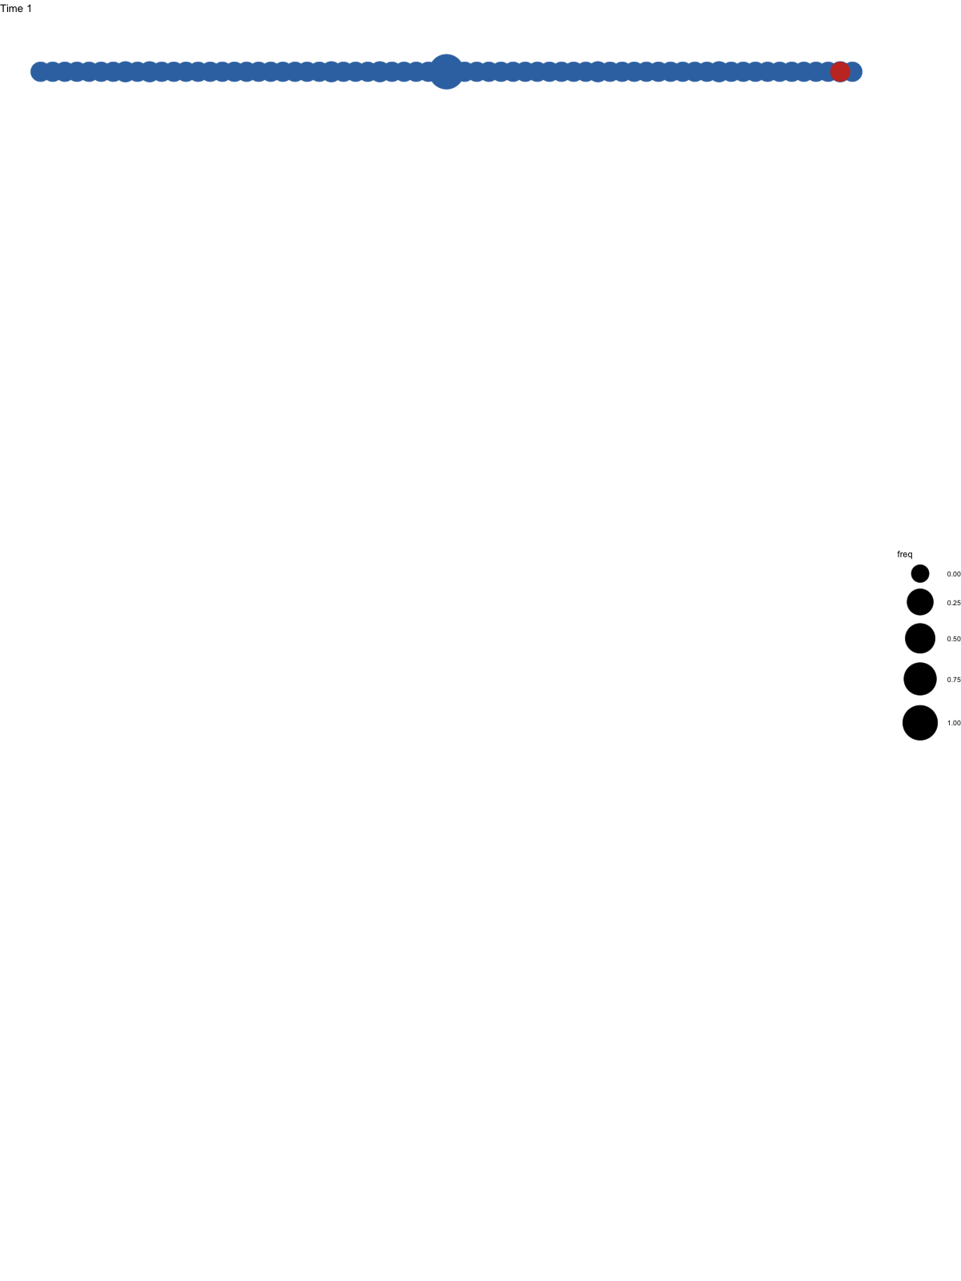
EvoFreq + HAL
animate_evogram() and the gganimate library can also be used to create animated dendrograms
library(gganimate)
# Generate frames
dendro_movie_info <- animate_evogram(hal_info$size_df,
hal_info$clones, hal_info$parents,
fill_value = hal_info$attributes$Color)
# Add gganimate object to dendro_movie_plot to finish animation
movie_p <- dendro_movie_info$animation_plot +
transition_time(time) +
ease_aes() +
exit_shrink() +
ggtitle('Time {frame_time}')
denodro_gif <- animate(movie_p, width=1600, height=800, renderer=gifski_renderer(loop=FALSE))
anim_save(filename="dendro_animation.gif", denodro_gif)

Slide 28


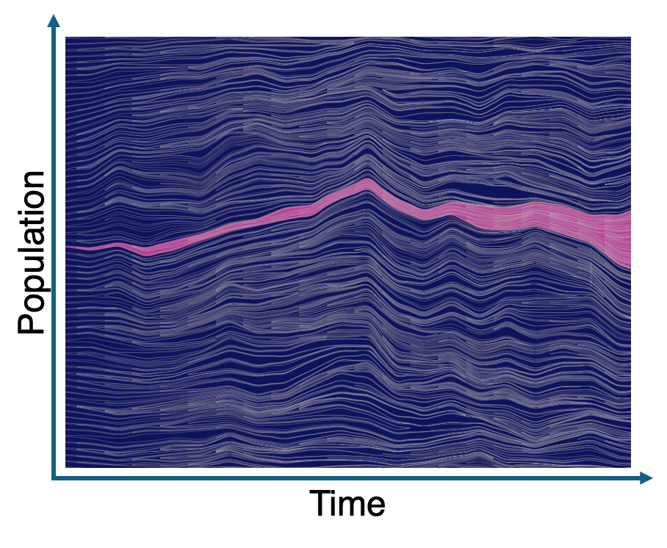
HAL + Evo Freq
Moran Process
One example: Moran process
Wildtype
Mutant
Untreated
therapy

Slide 29
Tutorial
get-evofreq
HAL Clone
plot-evofreq
Inc Pop & Dec Pop
Output to CSV
annotate
Example Attributes

